Slide 1

Opening a New Coffee House in Ha Noi, VietNam
Applied Data Science Capstone Project
IBM Data Science Professional Certificate Specialization
Nguyễn Xuân Toản
https://github.com/nxtacctau
Hà Nội, 2019.

Slide 2
Introduction
This report is for the final course of the Data Science Specialization. A 9-courses series created by IBM, hosted on Coursera platform.
The objective of this final assignment is to analyze and select best locations Ha Noi to open new coffee house. I use data science methodology and machine learning techniques that have learned through 9 course in IBM Data Science Professional Certificate such as data collection, data cleaning, Foursquare location data, clustering to answer the business question: where to open new coffee how in Hanoi.

Slide 3
Data
List of Districts (neighborhoods) in Ha Noi.
Latitude and longitude coordinates of those neighborhoods to plot map and to get the venue data.
Venue data include coffee house data to perform clustering on the neighborhoods.

Slide 4
Methodology
Use Data of Districts in Ha Noi.
Get Latitude and longitude coordinates using Geocoder
Visualize the map using Folium
Get venue Data using Foursquare API
Group Data by Dist (Neighborhood) and calculate the mean of the frequency occurrence of each venue category.
Filter venue category by Cafe
Use Kmeans clustering on the data to perform clustering on the data.
Visualize the clusters in a map using Folium

Slide 5
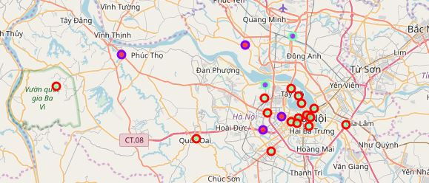
Results
3 Clusters have been made:
Cluster 0: Districts with moderate number of coffee houses
Cluster 1: Districts with high number coffee houses
Cluster 2: Districts with low number to no existence of coffee houses

Slide 6
Discussion
Most of the coffee houses are in the districts that not located in center of Hanoi.
Because of the rent price of properties in center Hanoi is very high so that investors did not invest in coffee house in the center of Ha Noi.

Slide 7
Conclusion
Only 1 factor as frequency of occurrence of coffee houses is used to find out the answer for the question from business.
There are other factors such as population, income, the price of property, etc... that could influence the decision for investor to invest in coffee house.
Through this project I show that with data science methodology, toolboxs we can use to solve real business problems.
We need to invest more money to get data and register the paid account in Foursquare to get more information.

